Slide 1
Active Appearance Models
T. F. Cootes, C.J. Taylor, G. J. Edwards
M. B. Stegmann
Computer examples
A. Torralba

Slide 2
AAM = Analysis by synthesis
Ingredients:
1) A database of annotated objects.
2) Synthesis method for generation of photo-realistic images
from model parameters.
3) Analysis: extraction of model parameters from images.

Slide 3







1) Toy training database
Labeling the training data set is one of the main difficulties
of the approach.
RoboFaces

Slide 4
2) Image warping
Synthesis method for generation of photo-realistic images
from model parameters
The main building block of AAM is the image warping procedure.
It is a function that applies a deformation to an image
given a set of corresponding points:
x1
y1

Slide 5
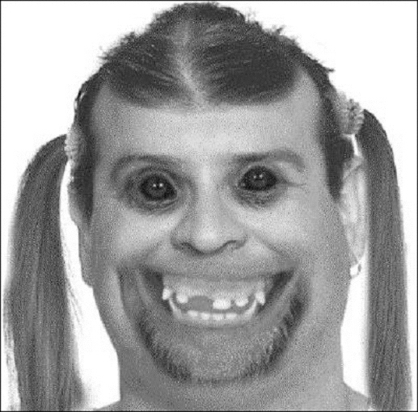
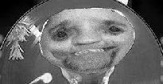
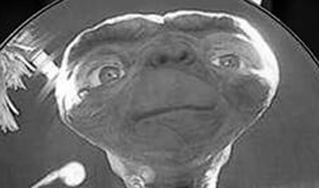
2) Image warping
Background
Original image
The Matlab implementation is limited to convex objects but this is good enough for faces.
= ImageWarp ( , , , )
background
This function is used during the iterations of the AAM.

Slide 6












2) Upgrading the toy training database
We warp a “real” face into the roboFaces in order to have
more realistic images. We have same modes of variation.

Slide 7
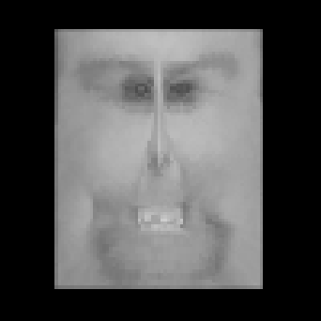
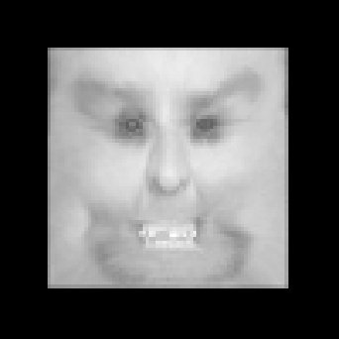
Appearance Model
Each image is represented as a collection of correspondence
points (shape) and a texture image normalized in shape.
x1
x2
...
xi
Shape information
(texture free)
Texture information
(shape free)
Original
image
I
Shape normalization is obtained by warping the image into
the mean shape of the training database.
Shape
free texture
Mean
shape
Original
image
zeros
shape
= ImageWarp ( , , , )

Slide 8
Shape model
PCA of shape information for the training database:
PC1
PC2
PC3
PC4
PC5
PC6
Each shape can be decomposed as:
Shape
Mean shape
=
+ s1
+ s2
+ s3
+ ...

Slide 9
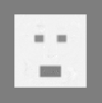
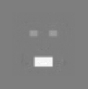
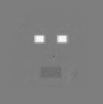
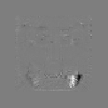
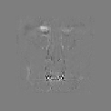
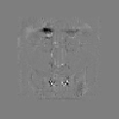
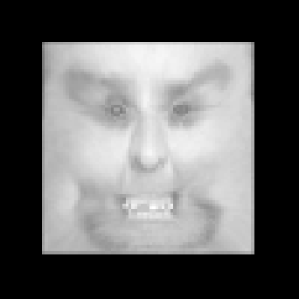
Texture model
PCA of texture information for the training database:
The PCA is done on the shape free images
PC1
PC2
PC3
PC4
PC5
PC6
Each texture (shape free) can be decomposed as:
Shape free
texture
Mean texture
=
+ t1
+ t2
+ t3

Slide 10
Appearance Model
shape
Original
image
=
+ s1
+ s2
+ s3
+
texture
=
+ t1
+ t2
+ t3
AAM uses an additional PCA, to reduce redundancy between texture and shape.
Original
image
shape
zeros
Mean
shape
Shape
free texture
= ImageWarp ( , , , )
s
t

Slide 11
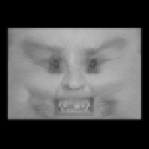
3) Active Appearance Model Search
Given a “face” the model has to build an appearance model
(shape + texture) that reproduces the original image.
Shape = ?
Texture = ?
This is done in an iterative procedure that tries to minimize the
reconstruction error.

Slide 12
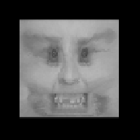
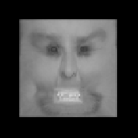
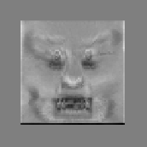
Two elements of the iterative procedure:
1) given a set of shape parameters, warp input image into its shape
free approximation:
mean
shape
estimated
shape
Input
image
zeros
= ImageWarp ( , , , )
s
i
2) measure the residual image and correct the appearance model.
Normalized input
Δs
-
= F
=
Δt
t
3)
s
i
The residual is function of errors in
both shape and texture parameters
= Δs +
i+1
s
i
t
= Δt +
i+1
t
i

Slide 13
Learning to correct model parameters
Δs
-
= F
=
Δt
t
i
Linear approximation:
Matrix A is learned
by adding perturbations
to the parameters of the
training set. The residual
corresponds to the difference
between the image obtained
with the real parameters and
the one perturbed.
Δs
=
A
Δt
Column
vector

Slide 14
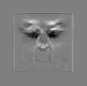
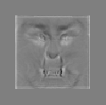
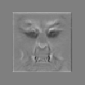
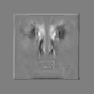
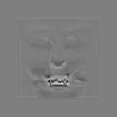
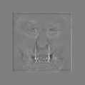
Learning to correct model parameters
Δs
A
Shape parameters:
=
s
vector
Each row of As describes how the residual contributes to each shape mode:
1st row of As
2nd row
3rd row
4th row
5th row
6th row

Slide 15
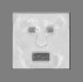
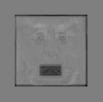
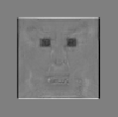
Learning to correct model parameters
Δt
A
Texture parameters:
=
t
vector
Each row of At describes how the residual contributes to each texture mode:
1st row of At
2nd row
3rd row

Slide 16










Results
Input image
Model
Shape
Residual
Iter =
1
5
10
100
Convergence after 50 iterations

Slide 17








Results
Even when the images have real parameters that deviate from the
distribution of the training set, the algorithm seems to converge:
Input image
Model
Shape

Slide 18
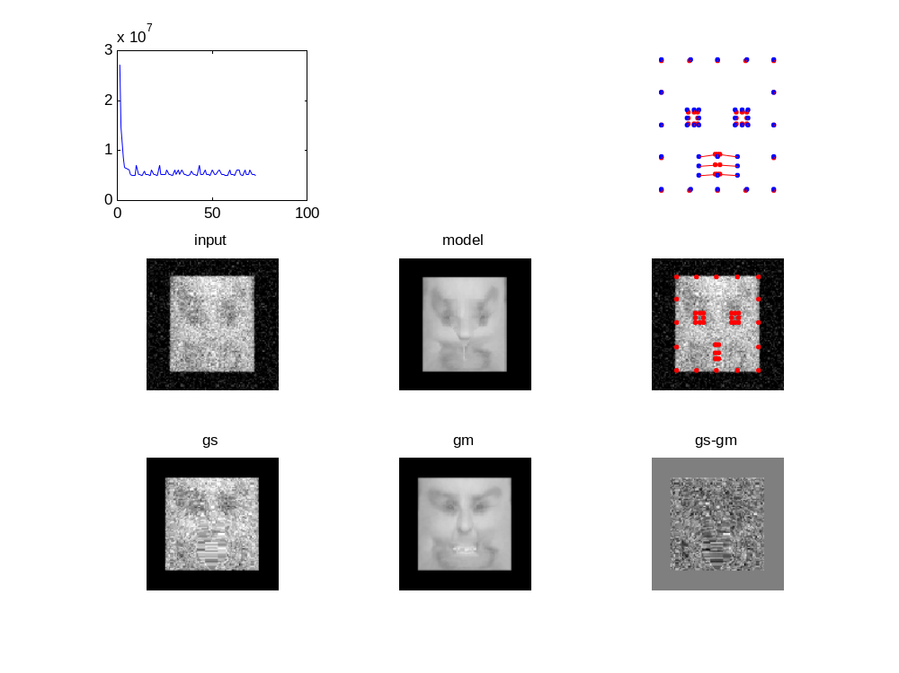
error
iter
Adding priors to possible appearance parameters may prevent this.

